Slide 1
Internet Protocol
Rushi Patel, Patrick Alarcon, Ryan Carriere, Roman Styrku, Paul Atkins

Slide 2
Topics
History of Ip and What is IP
Reliability, security, and uses of IP
Two versions of IP
IPv4
IPv6
How does IPv4 and IPv6 work
Limitations of IPv4 and IPv6
IPv4 vs IPv6
3 Types of IP addresses

Slide 3
History of IP
May 1974: The Institute of Electrical and Electronic Engineers (IEEE) published a paper by Vint Cerf and Bob Khan, named “A Protocol for Packet Network Internetwork Communication”, which described an internetworking protocol for sharing resources using packet switching in network nodes
One of the central control components of the proposed model was the Transmission Control Program(TCP). This model became known as the Department of Defense Internet Model and Internet Protocol Suite, or just simply TCP/IP.

Slide 4
History of IP
There have been a total of 7 versions of the Internet Protocol:
IPv0 to IPv3 were experimental versions made during the years 1977-1979 that slowly built upon each other. Each one came with a comments and revision that slowly did away with some aspects and added other aspects of the IP header. For example, IEN2 stated that there was a need to separate TCP/IP.
IPv4 is the version that was most commonly used throughout the internet prior to the exhaustion of IP addresses approaching
IPv5 was used by the Internet Streaming Protocol, an experimental Streaming protocol
IPv6 is the newest version of the IP, which has many newer features and features a larger pool of potential addresses.

Slide 5
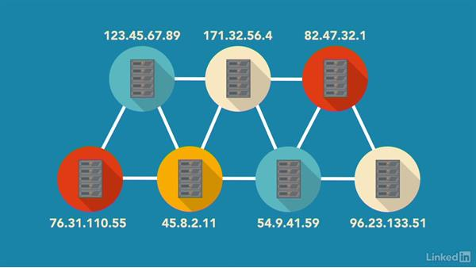
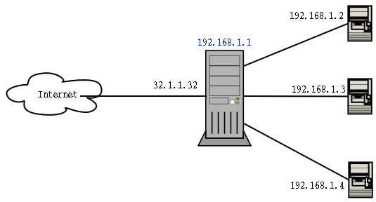
What is IP?
IP stands for Internet Protocol.
It is a protocol via which data is sent from one computer to another through the internet.
IP protocols operates at the network layer protocol of the OSI reference model.

Slide 6
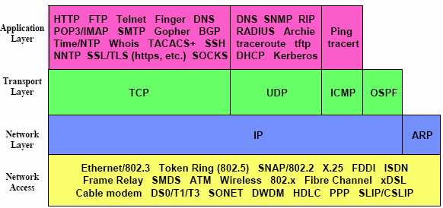
What is IP? (Continued)
IP uses datagram to communicate over a packet-switched network.
IP is a protocol that operates at the network layer protocol and is a part of a suite of protocols known as TCP/IP.
There are 2 versions of IP, IP version 4 (IPv4) and IP version 6 (IPv6).

Slide 7
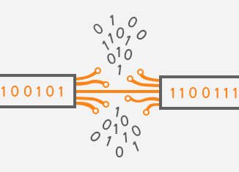
Reliability of IP
IP only provides best-effort delivery (the network does not provide any guarantee that data is delivered).
This leads to the service being characterized as unreliable.
Errors can include: packet loss, data corruption, and duplication.
Vendors are attempting to improve the reliability.
They are working on making the network layer better.
They are improving router code.
They are developing better hardware.

Slide 8
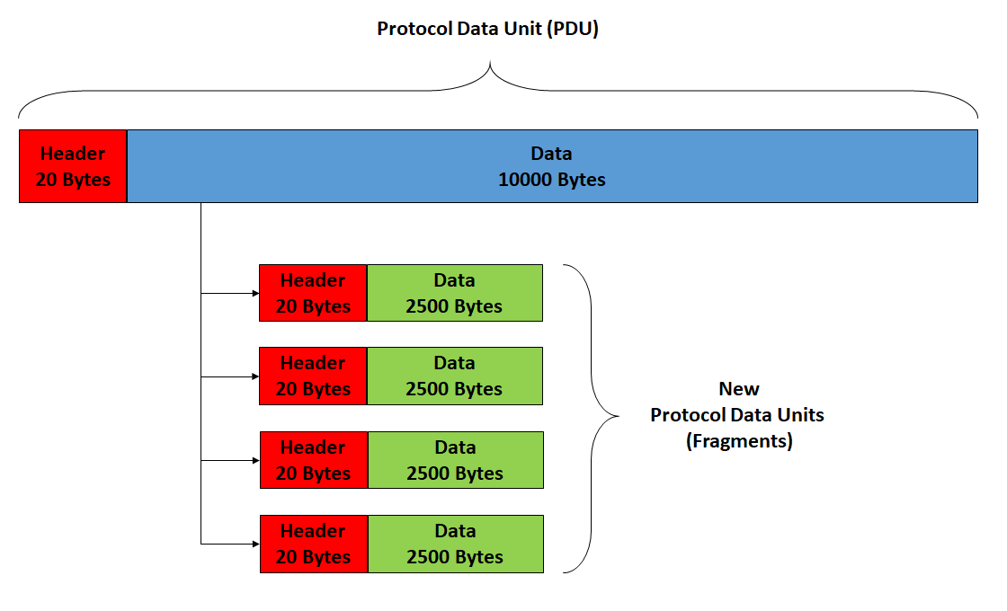
IP Link Capacity and Capability
The dynamic nature of the internet provides no guarantee that any path is actually capable of performing the data transmission requested.
IPv4 internetworking layer has the ability to automatically fragment packets into smaller units for transmission. IP provides re-ordering of fragments delivered out of order.
IPv6 does not offer fragmentation or reassembly.
TCP is one of the protocols that can adjust a segment size
UDP forces IP to fragment large datagrams.

Slide 9
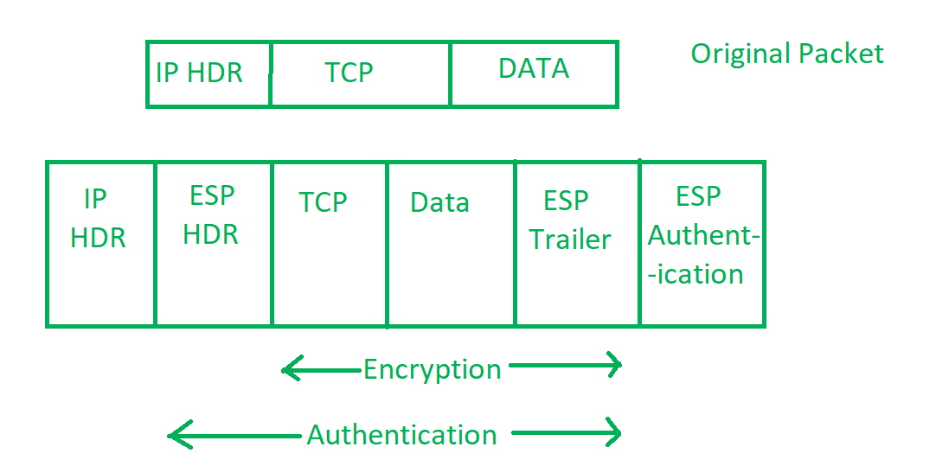
Security
IP Security is handled by the IPSec (IP Security).
It has three components:
Encapsulating Security Payload (ESP) – It provides encryption, authentication, data integrity, and anti-replay.
Authentication Header (AH) – It does everything that ESP does except provide encryption. It does not protect any data’s confidentiality.
Internet Key Exchange (IKE) – a network security protocol designed to dynamically exchange encryption keys and find a way over Security Association (SA) between 2 devices.

Slide 10
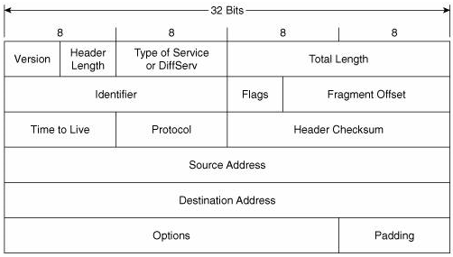
IP Version 4 Protocol
IPv4 is the fourth version of the IP and was the first version made for use in the ARPANET in 1983.
It is the most widely deployed Internet protocol used to connect devices on the internet.
IPv4 uses 32-bit address scheme allowing for a total of 2^32 addresses.

Slide 11
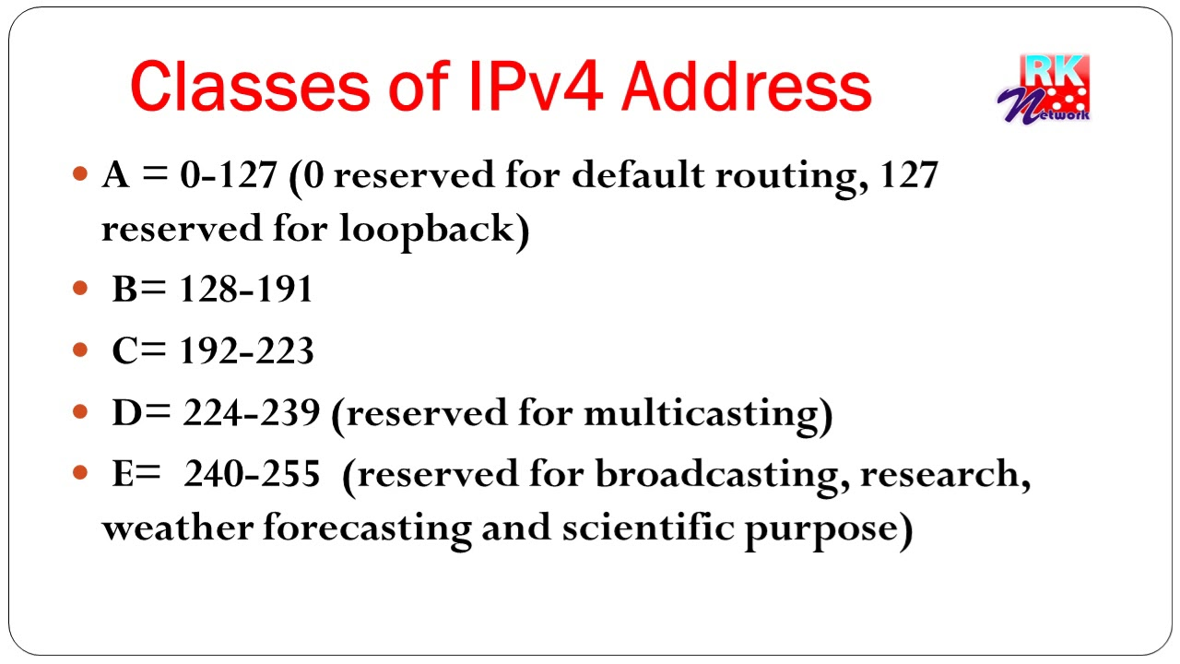
IP Version 4 Protocol
An IPv4 datagram consists of a header part and a body or payload part.
The header has a 20-byte fixed part and a variable-length optional part.
In IPv4 ethernet communication is done in five classes: A, B, C, D and E.
A, B and C have a different bit length for addressing the network host.
Class D addresses are reserved for multicasting.
Class E addresses are reserved for future use.

Slide 12
How does IPv4 Work?
IPv4 uses class-type address space for multicast use (224.0.0.0/4).
IPv4 uses “broadcast” addresses that forced each device to stop and look at packets.
IPv4 uses 0.0.0.0 as an unspecified address, and class-type address (127.0.0.1) for loopback.
IPv4 uses globally unique public addresses for traffic and “private” addresses.

Slide 13
Limitations of IPv4
IPv4 is not perfect, and has some limitations to it.
The most relevant limitation of IPv4 is that the original planners of it did not anticipate the exponential growth of the internet, and as such the 4.2 billion IPv4 addresses were exhausted within a relatively short period of time
In addition, there are some security issues that were not thought of during the development of IPv4. IPSec is not a built in protocol suit and is entirely optional.
Mainly because of the address exhaustion problem, there came a need to create an update to IPv4, which came in the form of IPv6

Slide 14
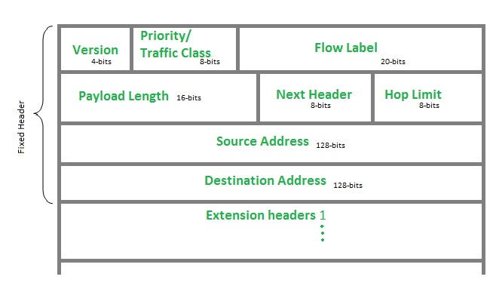
IP Version 6
IPv6 is new version of IP.
It was developed by the Internet Engineering Task Force as an upgrade to IPv4
The most common known upgrade is the length from 32-bits to 128-bits resulting in a lot more addresses.

Slide 15
IP Version 6
IPv6 does not have a checksum in the header.
It allows the host to send fragments packets but does not allow this with routers.
IPv6 uses the flow label field to identify packet flow for “Quality of service” handling by router..
It uses host addresses records in DNS to map the host’s name into a IPv6 address.

Slide 16
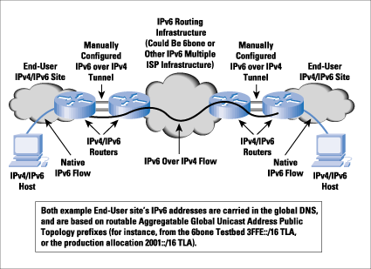
How does IPv6 work?
IPv6 addresses are 128-bit hexadecimal numbers
Link local unicast addresses are easy to identify
Leading zeros are suppressed
Inline zeros can sometimes be suppressed
Loopback addresses don't even look like addresses
You don't need a traditional subnet mask
DNS is still a valid technology
Can tunnel its way across IPv4 networks

Slide 17
IPv6 problems that can occur
IPv4 router cannot be updated to perform IPv6, you have to have IPv6 equipment.
A server that runs multiple services between IPv4 and IPv6 can have problems which can end up with confusion between servers.
Current ISP does not support IPv6

Slide 18
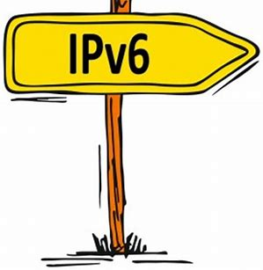
Benefits for IPv6
Address Abundance
Easier Management
End-to-end transparency
Mandated Security
Better mobility
Platform for innovation

Slide 19
Concerns migrating to IPv6
Convincing companies to convert to IPv6
It is extremely expensive
Would be very complex. All departments that use computers would have to work to together to transition to IPv6.
Cleaning current IPv4 inventory. It would involve getting new equipment, implementing it , and keeping the old for backup purpose.

Slide 20
IPv4 vs IPv6
IPv4 address is 32-bit while IPv6 is 128-bit.
IPv4 number representation is decimal while IPv6 is hexadecimal.
IPv4 has security feature that is dependent on application while IPv6 has a build in security system.
In IPv4, fragmentation is performed by sender and forward to the routers while in IPv6, fragmentation is performed only by sender.
In IPv4, the packet flow identification is not available while IPv6 packet flow identification is available which uses flow label field in the IPv6 header.

Slide 21
Types of IP address
Unicast
Multicast
Broadcast

Slide 22
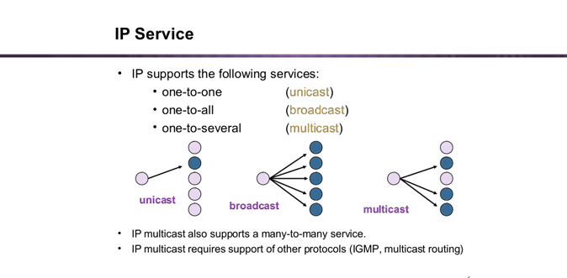

Slide 23
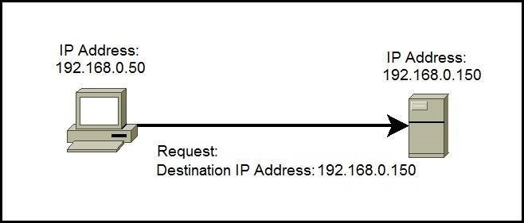
Unicast IP addresses
The address of a single interface
Used for one-to-one communication
Used to direction packets to a specific host

Slide 24
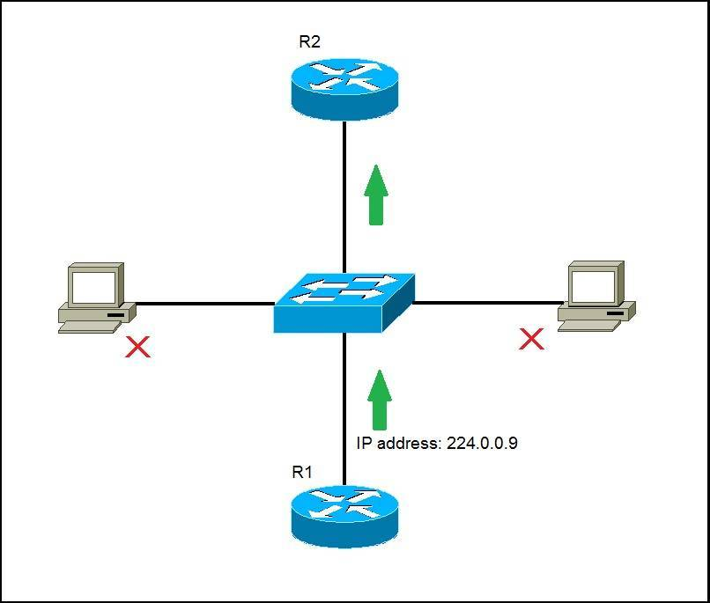
Multicast IP address
Used for one-to-many communication
Multicast messages are sent to IP multicast group addresses.
Routers forward copies of the packet out to every interface that has hosts subscribed to that group address.
The hosts that need to receive the message will process the packets.
Other hosts on the LAN will discard them.

Slide 25
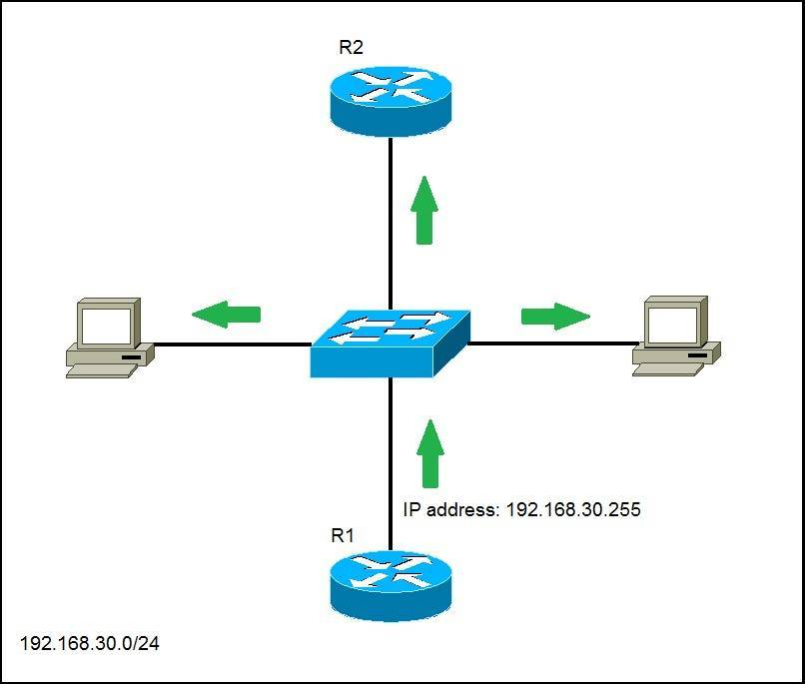
Broadcast IP address
Use for one-to-everybody communication
Used to send data to everyone in the broadcast domain.
The address for a network has all host bits on.

Slide 26
Static IP address
It is a IP address that does not change once assigned to the specific network.
This addressing is cost effective and have a high security risk.
Mostly used on the web, email, and gaming servers.

Slide 27
Dynamic IP addresses
The IP address changes each time the device logs onto the network.
Each IP address is assigned to the DHCP.
Is more secure than static.
Used when browsing the internet, receiving emails, and downloading files.

Slide 28
Public IP address
An address assigned to a computing device to allow direct access to the internet
Any web server, email server, etc can be directly accessed through the address.
It is globally unique, and can only be assigned to a unique device.

Slide 29
Private IP address
An address space that allows companies to create their own private network.
Three IP blocks for private use (A,B,C).
Most electronic devices have a private IP from some company.

Slide 30
Conclusion
An IP address defines a device’s connection to a network. Without the IP nothing can work on internet. Complicated networks and simple networks need the basic TCP/IP to function on the internet. IP addresses and ports form the foundation for these internet services.

